Slide 1
Pre-Colonial Sub-Saharan Africa
Bantus of sub-Saharan Africa
  Bantu Cultures, East and West
    Different ecological zones made full centralization difficult
    Eastern Bantu regions
      Centralized polities with king ruling by divine right
    Western Bantu-speaking communities
      Small-scale societies based on family and clan connections
      Organized into age groups
        Ruling elders
        Leaders based on talents
        Rights and duties
        Rituals
    Belief in spirits
      Diviners and charmers
  Migrations ultimately filled up more than half the African landmass
    Spread political and social order based on family and clans
    Rewarded individual achievement
    Close relationship with world of nature, spirituality

Slide 2
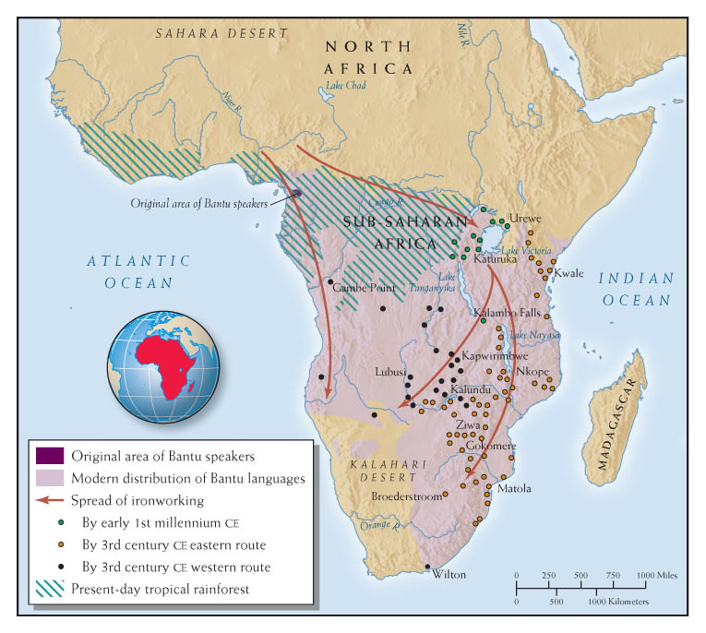
Map 8.6 | Bantu Migrations
WORLDS TOGETHER, WORLDS APART, CONCISE EDITION
Copyright © 2015, W. W. Norton & Company
Notes:
Map 8.6 | Bantu Migrations
The migration of Bantu speakers throughout much of sub-Saharan Africa in the first millennium CE dramatically altered the cultural landscape.
• According to the map, where did the Bantu speakers originate? Into which areas did the Bantu speakers migrate?
• What skills did they have that enabled them to dominate the peoples already living there?
• According to your reading, did the Bantu migrations create a common culture below the Sahara Desert during this time?

Slide 3
Islam in Sub-Saharan Africa
  Islam in Sub-Saharan Africa
    Islam crossed the Sahara and entered Africa carried by traders and scholars, not soldiers
    Trade joined West and North Africa and generated wealth, which created the great centralized political kingdoms in West Africa
      Ghana was the terminus of the North African trading routes
    Seafaring Muslim traders carried Islam into East Africa, as Islam became a dominant mercantile force in the Indian Ocean
    Trading communities exported ivory, slaves by 8th century CE
    Mixed African-Arab culture emerges
      African Bantu language absorbed Arab words and eventually became Swahili

Slide 4
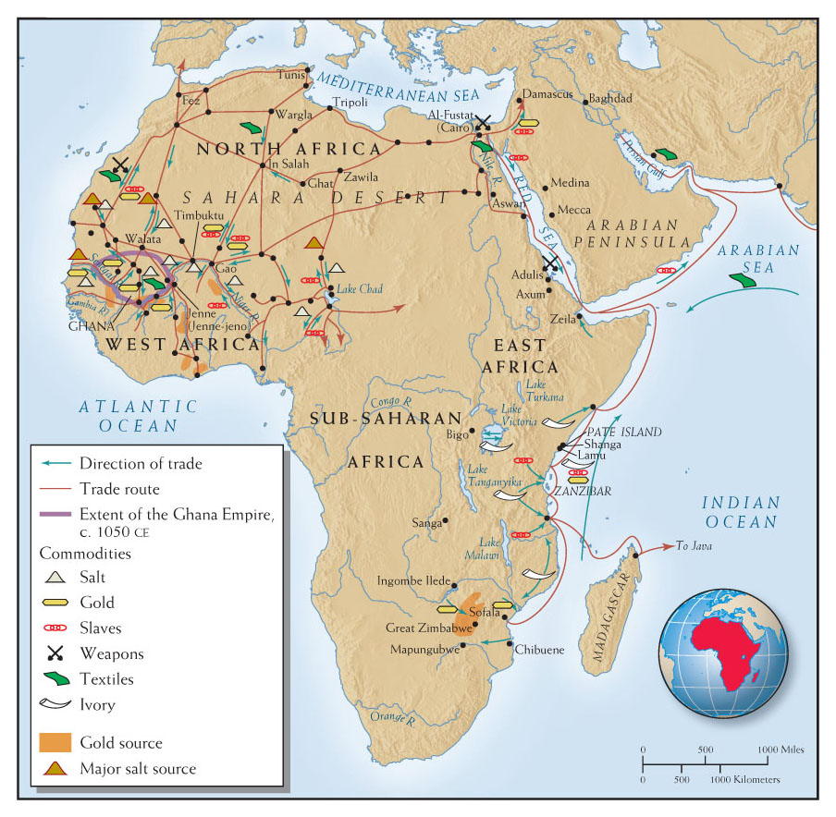
Map 9.3 | Islam and trade in Sub-Saharan Africa, 700-1000 CE
WORLDS TOGETHER, WORLDS APART, CONCISE EDITION
Copyright © 2015, W. W. Norton & Company
Notes:
Map 9.3 | Islam and Trade in Sub-Saharan Africa, 700–1000 CE
Islamic merchants and scholars, not Islamic armies, carried Islam into sub-Saharan Africa. Trace the trade routes in Africa, being sure to follow the correct direction of trade.
• According to the map key and icons, what commodities were Islamic merchants seeking below the Sahara?
• What were the major trade routes and the direction of trade in Africa?
• How did trade and commerce lead to the geographic expansion of the Islamic faith?

Slide 5
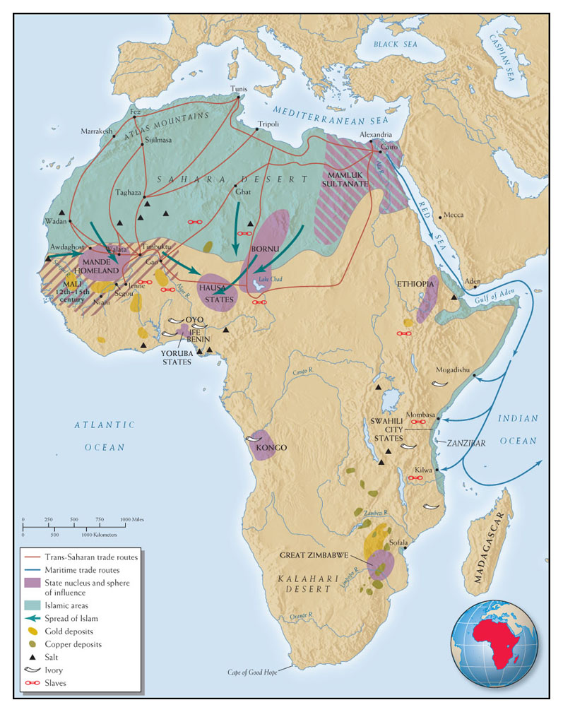

Slide 6
Trade between East Africa and the Indian Ocean
Eastern and southern African regions were also integrated into long-distance trading systems
  Wind patterns made East Africa a logical end point for Indian Ocean trade
  Swahili peoples living along the coast of East Africa became brokers for trade from Arabian Peninsula, Persian Gulf territories, and India’s west coast
  Most valued trade commodity was gold
    Mined between Limpopo and Zambezi rivers
    Mined by Shona-speaking peoples
    Great Zimbabwe was a center of gold mining
African slaves valued as much as gold in shipments to Indian Ocean and Mediterranean
  Quran attempted to mitigate the severity of slavery by requiring slave owners to treat their slaves with kindness and generosity
  Slave trade flourished under Islam
  Zanj rebellion in 9th century CE

Slide 7
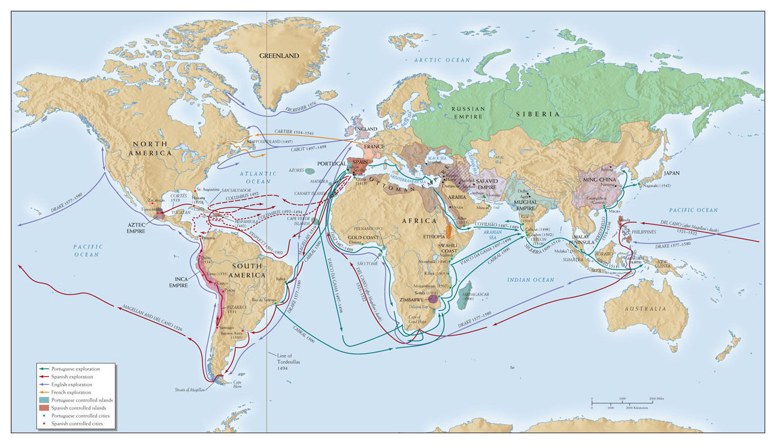
Map 12.1 | European Exploration, 1420–1580
WORLDS TOGETHER, WORLDS APART, CONCISE EDITION
Copyright © 2015, W. W. Norton & Company
Notes:
Map 12.1 | European Exploration, 1420–1580
In the fifteenth and sixteenth centuries, sailors from Portugal, Spain, England, and France explored and mapped the coastline of most of the world.
• Explain why Europeans would have chosen sea routes to reach Asia rather than land routes?
• Trace the voyages that started from Portugal, and then the voyages that started from Spain. Explain why Portuguese explorers concentrated on Africa and the Indian Ocean, whereas their Spanish counterparts focused on the Americas.
• Contrast the different patterns of exploration in the New World with those in the Indian Ocean and the South China Sea.

Slide 8
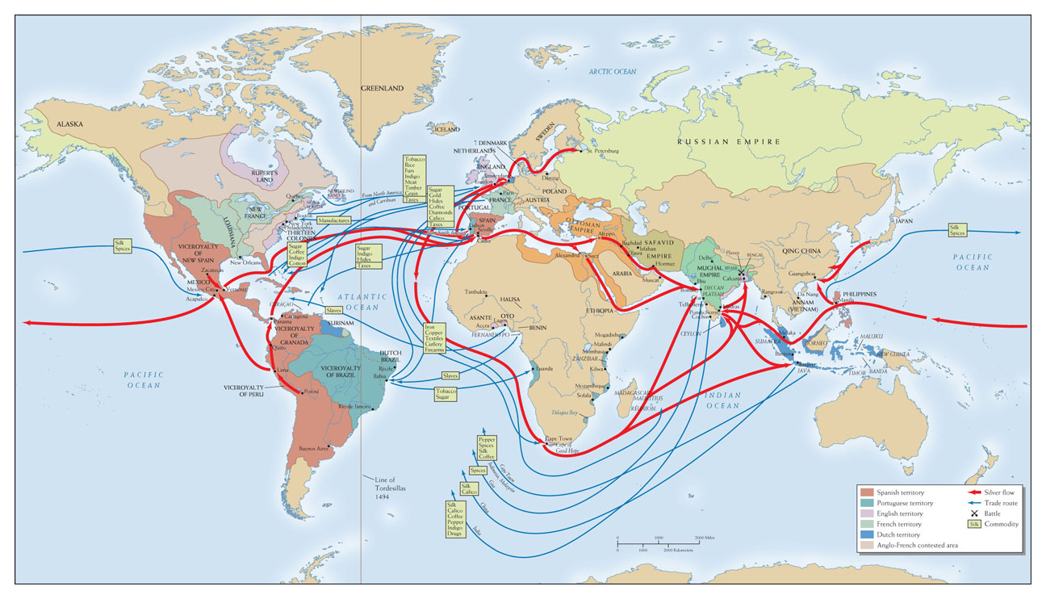
Map 13.1 | Trade in Silver and Other Commodities, 1650–1750
WORLDS TOGETHER, WORLDS APART, CONCISE EDITION
Copyright © 2015, W. W. Norton & Company
Notes:
Map 13.1 | Trade in Silver and Other Commodities, 1650–1750
The seventeenth and eighteenth centuries were the first centuries of true global commerce. Silver was the one item that was traded all over the world.
• Can you trace the flows of silver from the Americas around the globe (by following the thick red arrows) and identify the commodities that silver was exchanged for in different parts of the world?
• Does the map provide enough information for you to conclude which of these global empires was the wealthiest and most powerful?
• According to this map, how did increased trade shape European states’ territorial ambitions?

Slide 9
The Slave Trade and Africa
Human exports from Africa soared in the 17th and 18th centuries
  Essential to prosperity of Europe’s American colonies
  Depopulated and destabilized many parts of Africa
Capturing and Shipping slaves
  African elites controlled the capturing of slaves, using an existing system of slave commerce
  12.5 million Africans survived forcible enslavement and shipment to Atlantic ports from 1525-1867
  High death rates for slaves in Africa as well as on the trans-Atlantic journey
    Slaves waited for weeks aboard vessels in cramped and wretched conditions before even starting the journey
    Many slaves died en route of dehydration brought on by gastrointestinal diseases and lack of water, or smallpox and dysentery

Slide 10
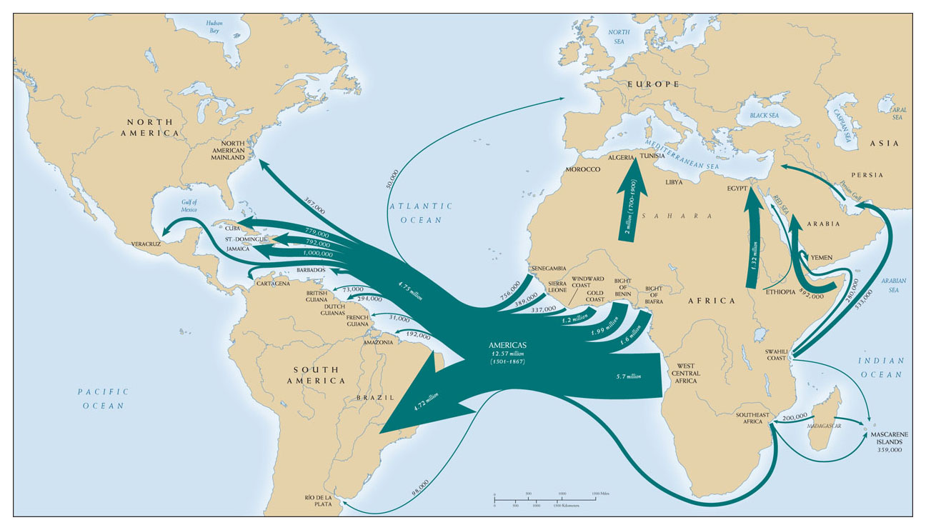
Map 13.4 | The African Slave Trade , 1501–1867
WORLDS TOGETHER, WORLDS APART, CONCISE EDITION
Copyright © 2015, W. W. Norton & Company
Notes:
Map 13.4 | The African Slave Trade , 1501–1867
The Atlantic slave trade flourished in the seventieth, eighteenth, and the nineteenth centuries, linking many parts of Africa with the Americas.
• What were the main areas of Africa from which the slaves were taken?
• What were the main areas that they were taken to in the Americas?
• Based on your reading, how and where did the slave trade reshape African societies?

Slide 11
Gender and Slavery
Slavery’s gender imbalance
  Gender-ratio imbalances played havoc in both Africa and the Americas
  European traders had to constantly procure more slaves from Africa, especially for the Caribbean, as there was little reproduction and high death rates
  Male slaves outnumbered female slaves in the New World, whereas slave-supplying regions in Africa had more women than men
  Women in Africa were prized for their roles in producing grains, leathers, and cotton
  Slave trade reinforced traditional practice of polygamy

Slide 12
The Slave Trade’s Impact on Africa
Africa’s New Slave-Supplying States
  Local political leaders and merchants actively supplied slaves to European slave buyers
  Trade shifted wealth and power from herd- or landowning families to suppliers or slaves (merchants and warrior elites)
  Slave trade prompted a century of civil war from 1665 in the Kongo kingdom
  Europeans fueled these conflicts and provided weapons to allies
  Slave trade helped some merchants and warlords consolidate and extend political power with wealth and arms
    Asante State: became wealthy because of gold, which allowed them to acquire firearms and slaves, further developing their military and economic power

Slide 13
The Slave Trade’s Impact on Africa, continued
  Although the slave trade enriched and empowered some Africans, it cost Africa dearly
    The Atlantic commercial system shifted wealth and power from rural to urban ports
    Demographic catastrophe, with severe population loss
    The trade enhanced warrior class
    Dislocations, internal power struggles and economic hardships precipitated rise and fall of West African kingdoms

Slide 14
Change and Trade in Africa
Increased domestic and world trade, especially the Atlantic slave trade, shifted the terms of state building
Abolition of The Slave Trade
  The slave trade became a subject of fierce debate in the late eighteenth century, even as it enriched and empowered many Europeans and some Africans
    Some argued that slave labor was less productive than free wage labor
    Others argued that traffic in slaves was immoral
    Quakers in both England and the United States lobbied to end the slave trade

Slide 15
Abolition of the Slave Trade
  Abolitionists achieved success in prohibiting the slave trade
    Denmark banned the slave trade in its Caribbean colonies,1803
    Great Britain banned it in 1807, and the United States banned it in 1808
    France and other European governments persuaded over time
    Britain posted naval squadron off coast of West Africa to prevent slave trade above the equator
    By 1850, the number of slaves traded had dropped sharply
  Slavery didn’t end for several more decades due to profitability of
    Cotton in Southern US
    Sugar in Caribbean
    Coffee in Brazil

Slide 16
Abolition of the Slave Trade
  Abolitionists achieved success in prohibiting the slave trade
    Denmark banned the slave trade in its Caribbean colonies,1803
    Great Britain banned it in 1807, and the United States banned it in 1808
    France and other European governments persuaded over time
    Britain posted naval squadron off coast of West Africa to prevent slave trade above the equator
    By 1850, the number of slaves traded had dropped sharply
  Slavery didn’t end for several more decades due to profitability of
    Cotton in Southern US
    Sugar in Caribbean
    Coffee in Brazil

Slide 17
New Trade With Africa
New Trade with Africa
  European traders promoted a new form of commerce, “legitimate” trade
    Europeans wanted Africans to substitute trade in produce for trade in slaves
    West Africans began to export palm oil, peanuts, and vegetable oils
  A new generation of successful West African merchants amassed fortunes
    King Jaja of Opobo (1821–1891) started off a slave and ended up founding port of Opobo with the palm oil trade
    William Lewis, a freed Yoruba slave, went back to Africa in 1828, and became a successful merchant
      Sent his son Samuel to study in England
      Samuel became an important leader in Sierra Leone

Slide 18
Slavery in Africa
  Rise of free labor in Atlantic world and dwindling foreign slave trade actually strengthened slavery within Africa
    By mid-19th century, slaves were 50% of the population in some areas
    Slaves worked in palm oil or close plantation labor, military forces, or as palm oil or ivory porters, not domestic servants
    In 1850, northern Nigeria had had more slaves than independent Brazil, and almost as many as the United States
    Africa became in time the largest slaveholding continent

